Slide 1
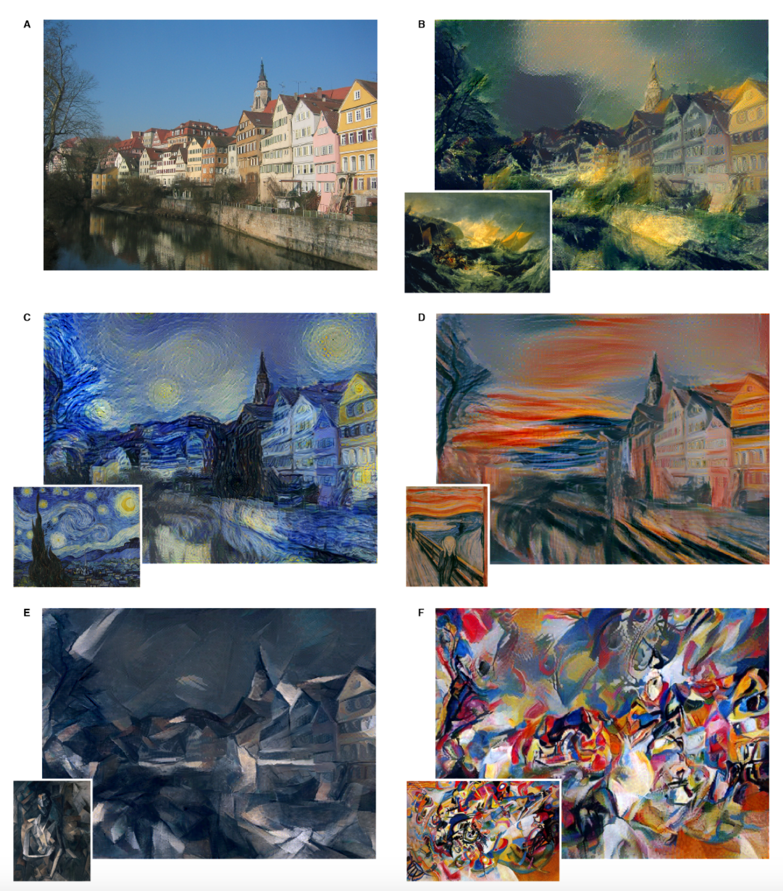
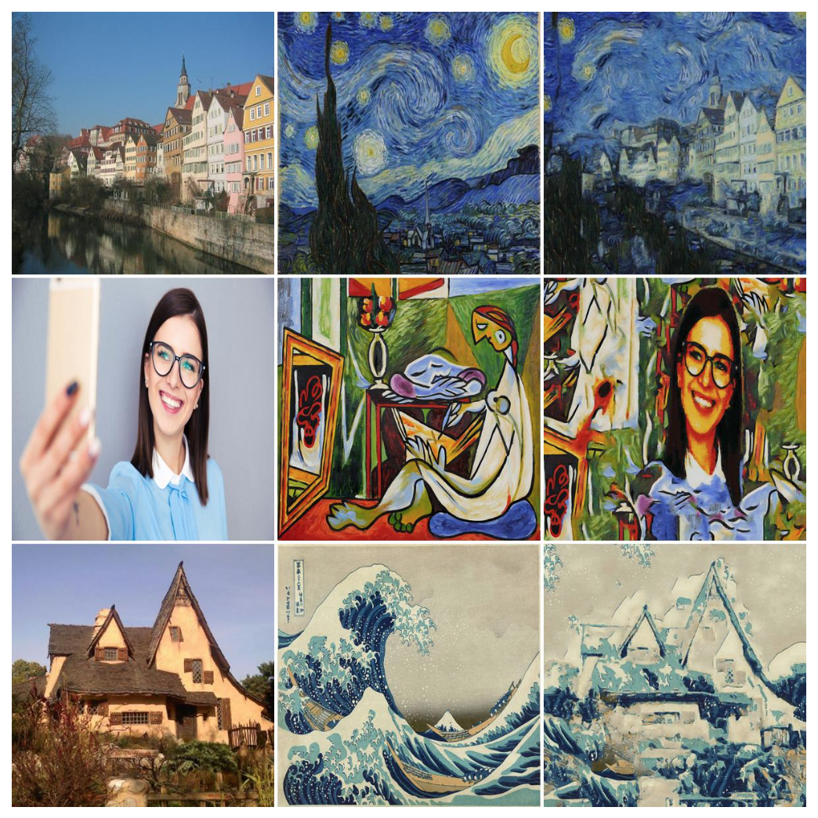
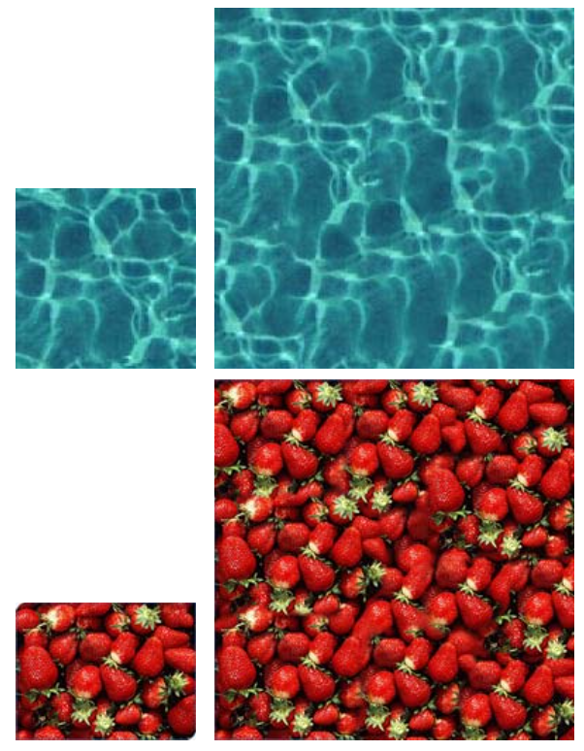
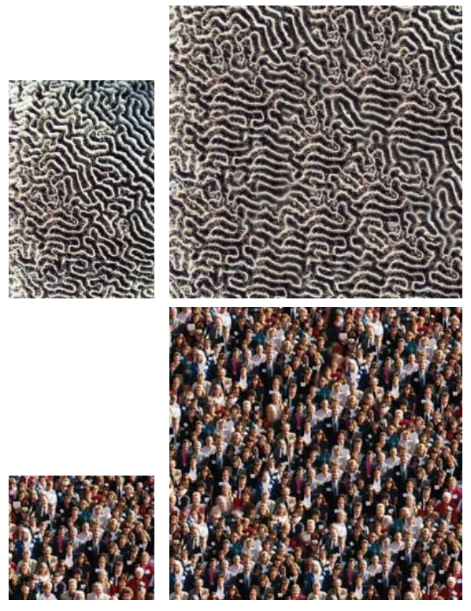
Artistic Style Transfer
Nicholas Tan, Elias Wang
Department of Electrical Engineering, Stanford University
Motivation
Algorithm Overview
Experimental Results
Initialization
Leon A. Gatys, Alexander S. Ecker, Matthias Bethge
Using a biologically inspired vision model, called “Deep Neural Networks,” an artificial system can be trained to learn different styles of painting and subsequently recreate images rendered in that style.
The model is successful because it is able to distinguish between “style” vs. “content”
Hallucination
BG/FG Segmentation
Iterate over patch size
Iterate over scale
Patch matching: NN
Related Work
Texture Synthesis: IRLS
Using a modification (Elad) of Texture-Synthesis (Kwatra), it is possible to get fast and comparable style-transfer results. This method focuses on separating information-poor areas to hallucinate the style and high content areas where it keeps the original image
Content Fusion: W. Avg
Color Trans: Hist Match
Denoise: Bilateral Filter

